Slide 1
Mastering the Art of Digital Accessibility Requirements
Jack Nicolai
nicolai@adobe.com
Accessibility Product Manager, Creative Cloud
at Adobe Systems, Incorporated
Presentation assets: http://bit.ly/mastera11ycsun

Slide 2
Agenda
Problem Statement
Solution
Roles and responsibilities
Methods

Slide 3
Problem Statement
Accessibility requirements are not documented clearly, consistently or in a way that other professionals can easily understand and act upon them.
Notes:
I interact with a lot of people who know little to nothing about accessibility, but are being tasked with making their applications accessible. Until we a have a certain level of fluency in accessibility I tend to document accessibility requirements in detail. This is in part to educate and to anticipate where questions may arise. Ultimately, the point of this presentation today is to get us talking.

Slide 4
Solution
Employ standard documentation methods to express accessibility requirements, which can be written by professionals knowledgeable about accessibility, understood by stakeholders, actionable by engineers and used as a basis to validate functionality.
Create artifacts that document requirements, which then drive conversations about how to make your software accessible.
Notes:
This is a lofty goal of which I haven’t fully achieved success. What I share with you today are things that I commonly do in my own work and have seen different versions of from other accessibility professionals.

Slide 5
Authors of Accessibility Requirements
Product Manager
Experience Designer
Graphic or Product Designer
Content Strategist
Accessibility professional
Notes:
This is a representative list which may include additional roles not listed. Can you think of anyone else who would define accessibility requirements for your project?

Slide 6
Consumers of Accessibility Requirements
Experience Designer
Graphic or Product Designer
Content Strategist/Writer
Engineer
Tester
Business stakeholder
Accessibility professional
Notes:
Who else might utilize the accessibility requirements you define?

Slide 7
Communicating Accessibility Requirements
User stories
Wireframes
Design comps
Design specs or patterns
Technical specs
Prototypes
Test cases
Notes:
We will be looking at a few methods of expressing accessibility requirements that will help to address the WCAG principles; Perceivable, Operable, Understandable and Robust. In particular we will look at a set of graphical elements used to help communicate accessibility requirements in wireframes or design comps and how those assets can be includes in user stories.
What other formats do you use to communicate accessibility requirements?

Slide 8
Methods
User Stories
Design Specs
Test Cases
Notes:
I will be presenting three methods in which to deliver accessibility requirements: user stories, design specs and test cases.

Slide 9
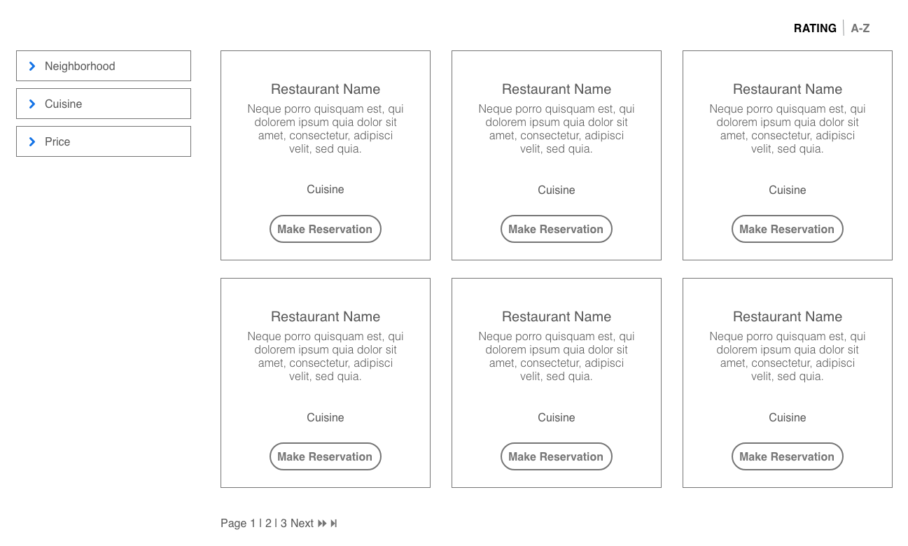
Search Results Interface
Notes:
Image description: A design spec with an annotated wireframe of a search results interface to find a local restaurant. On the left is a set of accordion controls to filter search results. The main content contains the search results, a toolbar to sort by Rating or Alphabetically and pagination controls following search results.
One of the key requirements to communicate is the order in which a user interacts with an interface. This a common interface used to search and filter a set of information. In this example, I am searching for restaurants near me. Along the left rail is a set of collapsed accordion style categories of filters; Neighborhood, Cuisine, and Price. In the main content area to the right of the filters is a set of search results displayed as a grid of cards. Each of the cards summarizes a result and may include related links or calls to action. There is a toolbar above the results which allows you to sort the results by rating or alphabetically. Below the first set of results is a navigation region in a numbered pagination format with a “next” and “last page” link.

Slide 10
Method: User Stories
Accessibility Requirements

Slide 11
What is a User Story?
A user story is a high-level (user-centered) definition of a requirement (which delivers value), containing just enough information so that the developers can produce a reasonable estimate of the effort to implement it (and tests can be written to validate it).
"As a <role>, I want <goal/desire> so that <benefit>"
Stories may include additional information and resources such as additional context, acceptance criteria, diagrams, technical specifications and links to other resources.
Notes:
There are lots of ways you can slice functionality. Typically, user stories encompass a complete slice of functionality. For the purposes of this presentation I am slicing functionality into more discreet pieces for the purposes of clarity and more discreet test definition.
This is not an all or nothing situation. Take from this example the elements that are useful to help you define and test a requirement.

Slide 12
User Story: 1 of 3
Title: Keyboarding – Search Results
Description: As a keyboard-only user, I want to keyboard navigate and filter the search results for restaurants near me so that I can find a place to eat. Focusable elements should be in a logical order and display a clear indication of focus.
Notes:
See Kathy Walbin’s article, How to Write User Stories for Web Accessibility.
The input device of choice be swapped out for the keyboard, touch, switch-device, etc.

Slide 13
User Story: 2 of 3
Acceptance Criteria:
All functionality of the content is operable through a keyboard interface.
TAB key moves through the list of search results in the natural keyboard order of the Document Object Model (DOM).
With focus on a filter heading, the SPACE or ENTER key will expand the filter accordion. The elements inside an expanded filter should then be added to the tab order in the manner indicated in the associated diagram.
When focus is on a filter heading, RIGHT ARROW will expand the accordion, LEFT ARROW will collapse the accordion.
When focus is on one of the children of the accordion, Pressing DOWN/UP ARROW key will move focus to the next or previous filter in the list.
Notes:
While there are a number of different things which much be communicated regarding accessibility, at minimum you want to communicate how someone gets to an element in the interface, the elements label, role and state/properties when it have focus and how to interact with the element.

Slide 14
User Story: 3 of 3
Context:
WCAG 2.0
2.1.1 Keyboard
2.4.3 Focus Order
1.3.2 Meaningful Sequence
ARIA 1.1 Authoring Practice (Design Pattern)
3.1 Accordion
3.11 Grids
3.22 Toolbar

Slide 15
Method: Bluelines
Annotating Accessibility

Slide 16
Key concepts to annotate
Wayfinding
Focus order
Keyboarding – tabbing, shortcuts
Content structure
The content behind the content
Label, role, state, and properties
Screen Reader-only content

Slide 17
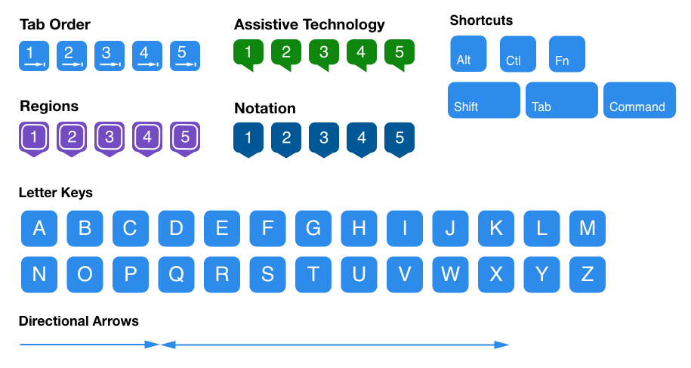
Accessibility Annotations
Notes:
Image description: A set of graphical assets sets use to communicate, tab/focus order, keyboard shortcuts, attributes for assistive technology, (landmark) regions and directional arrows.
I created this set of graphical assets in Illustrator. I chose Illustrator because of the various image formats I can export including SVG and the support to copy/paste these assets as vectors into other applications including Adobe Experience Design and Sketch. I could also include these assets in a Creative Cloud library so that I can easily share them with other Creative Cloud subscribers.
Additions could include notation for swipe gestures for touch interfaces, particularly for VoiceOver, TalkBack and Windows 10.
Because no idea is completely original I want to be sure to give credit where it is due. This set of graphical annotation assets is informed by work I have encountered while collaborating with other accessibility professionals, namely Ben Truelove at Microsoft and Bo Campbell and M.E. Miller at IBM.

Slide 18
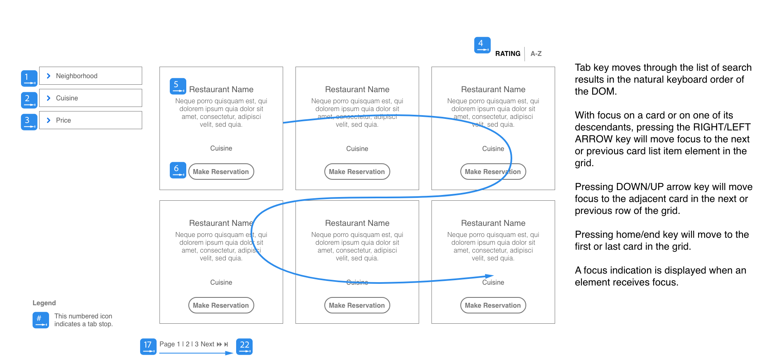
Keyboarding and Focus Order
Notes:
Image description: A design spec with an annotated wireframe of a search results interface to find a local restaurant. which depicts tab order and keyboarding. On the left is a set of accordion controls to filter search results. The main content contains the search results, a toolbar to sort by Rating or Alphabetically and pagination controls following search results. Read accompanying information for keyboarding details.
Tab key moves through the list of search results in the natural keyboard order of the DOM.
With focus on a card or on one of its descendants, pressing the right/left arrow key will move focus to the next or previous card list item element in the grid.
Pressing down/up arrow key will move focus to the adjacent card in the next or previous row of the grid.
Pressing home/end key will move to the first or last card in the grid.
A focus indication is displayed when an element receives focus.
Grid focus order using LEFT ARROW | RIGHT ARROW. Using the LEFT and RIGHT arrow keys moves left to right through each of the grid before moving to the next row.
Grid focus order using UP ARROW | DOWN ARROW. Using the UP and DOWN arrow keys moves vertically through columns of the grid.
ARIA Design Patterns: Accordion, Grid, and Toolbar.

Slide 19
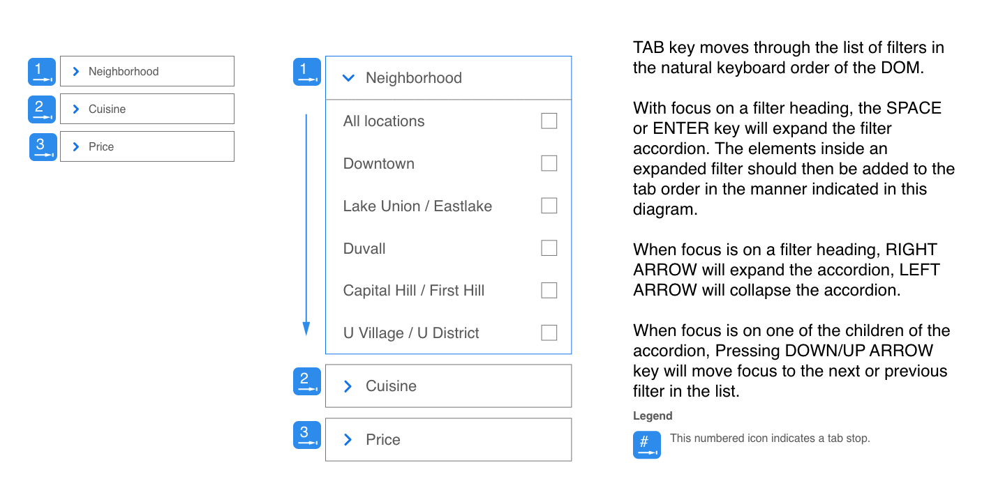
Focus Order – Accordion detail
Notes:
Image description: A design spec with an annotated wireframe of three accordion style controls which depicts tab order and keyboarding. Read accompanying information for keyboarding details.
TAB key moves through the list of filters in the natural keyboard order of the DOM.
With focus on a filter heading, the SPACE or ENTER key will expand the filter accordion. The elements inside an expanded filter should then be added to the tab order in the manner indicated in this diagram.
When focus is on a filter heading, RIGHT ARROW will expand the accordion, LEFT ARROW will collapse the accordion.
When focus is on one of the children of the accordion, Pressing DOWN/UP ARROW key will move focus to the next or previous filter in the list.
ARIA Design Patterns: Accordion, and Checkbox

Slide 20
Accounting for Assistive Technology: 1 of 2
Label, role, state
announced immediately
aria-label, aria-labelledby
Hint/description/aria-describedby
Announced after a slight pause
Can be turned off in AT preferences
AT (announcement)
An approximation of what will be announced by AT to guide engineers and testers

Slide 21
Accounting for Assistive Technology: 2 of 2
Name, Role, State and Properties
label=“Neighborhood”
role=“button”
expanded=“true”,
description=“Select a filter to narrow your search results.”
AT: “Neighborhood, expanded, button, (pause) Select a filter to narrow your search results.”
Notes:
The order in which these elements are announced by assistive technology will vary. The idea is to provide engineers and testers an idea of what they should expect.

Slide 22
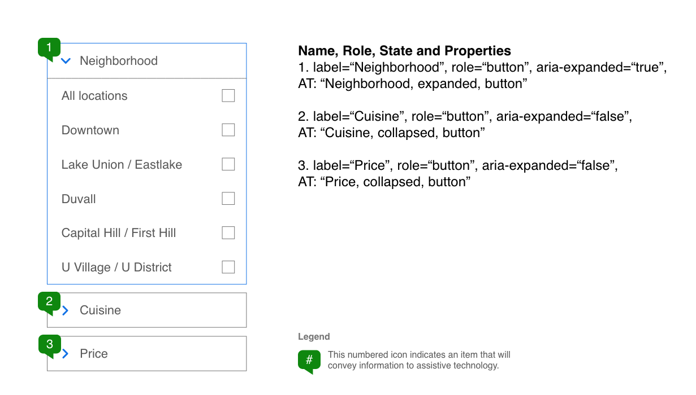
Assistive Technology – Accordion
Notes:
Image description: A design spec with an annotated wireframe of three accordion style controls used to display search filters with details regarding name, role, state and properties for each accordion header. The filters categories are Neighborhood, Cuisine, and Price. The Neighborhood accordion is expanded to show neighborhoods in the Seattle area.
Name, Role, State and Properties
label=“Neighborhood”, role=“button”, aria-expanded=“true”, AT: “Neighborhood, expanded, button”
label=“Cuisine”, role=“button”, aria-expanded=“false”, AT: “Cuisine, collapsed, button”
label=“Price”, role=“button”, aria-expanded=“false”, AT: “Price, collapsed, button”

Slide 23
Content Structure
Utilize the semantic structures available in HTML
Heading levels
<fieldset> and <legend> for groups of elements
Lists
Regions
Default regions via HTML5
Labelled regions

Slide 24
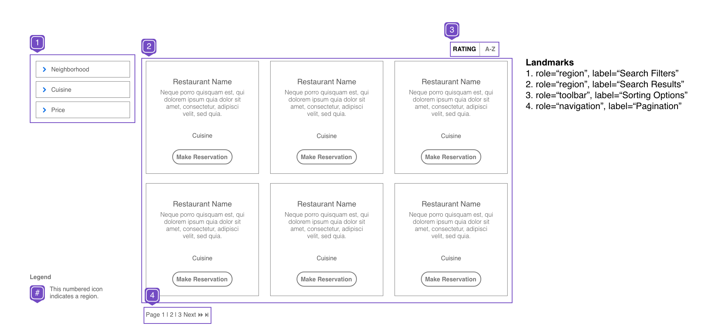
ARIA Landmark Regions
Notes:
Image description: Wireframe of a restaurant search results page annotated to indicate landmark regions for the search filters, sorting toolbar, search results and paginated navigation.
Landmarks
role=“region”, aria-label=“Search Filters”
role=“region”, aria-label=“Search Results”
role=“toolbar”, aria-label=“Sorting Options”
role=“navigation”, aria-label=“Pagination”
Preferably headings would be used to describe each section and would be referenced using aria-labelledby instead of a static aria-label value.

Slide 25
Method: Test Cases
Accessibility Testing

Slide 26
Types of Acceptance Criteria – Page Level
1.3.1 Info and Relationships
1.3.2 Meaningful Sequence
1.4.1 Use of Color
1.4.3 Contrast
1.4.4 Resize Text
2.1.1 Keyboard
2.1.2 No Keyboard Trap
2.2.1 Timing Adjustable
2.3.1 Three Flashes or Below Threshold
2.4.1 Bypass Blocks
2.4.2 Page Titled
2.4.4 Link Purpose
2.4.5 Multiple Ways
2.4.6 Headings and Labels
3.1.1 Language of Page
3.2.3 Consistent Navigation
3.2.4 Consistent Identification
4.1.1 Parsing
Notes:
See WCAG 2.0 online for details on these criteria.

Slide 27
Types of Acceptance Criteria – Component Level
Single Component
Images
Multimedia
Form elements
Tables
Complex Component
Accordion
Carousel
Dropdown
Dialog
Menu
Notes:
Typically, each of the single components have direct relationships to WCAG 2.0 criterion. For example, Images are covered by 1.1.1 Non-text Content. Complex components are combinations and single components and also be covered by 1.3.2 Meaningful Sequence.

Slide 28
Acceptance Criteria Format
Given some initial context
When some action is carried out or event occurs
Then a particular set of observable consequences result
Notes:
See the Sarah Pulis presentation, Reusable Acceptance Criteria and Test Cases for Accessibility.

Slide 29
Acceptance Criteria for an Accordion
Given that I have focus on the heading of an accordion, when I press the ENTER or SPACE key to toggle the accordion, (then) the associated panel toggles between expanded or collapsed (2.1.1 Keyboard, 4.1.2 Name, Role, State)
Checks:
Role=“button”, using native HTML control or ARIA role=“button”
Name – using one of the following methods: label, aria-label, or aria-labelledby
State – using aria-expanded
Relationship – using aria-controls to point to associated panel

Slide 30
Digital Accessibility Toolkit
User Story example (Rich Text Format)
Accessibility annotation assets (Illustrator and SVG)
Wireframe examples (Adobe XD CC and PNG formats)
Test Case example (Rich Text Format)

Slide 31
Additional Considerations
Style Guides
Pattern Libraries
Color Contrast
Tooltips
Keyboard shortcuts
Touch and gestures
Additional content for assistive technology users, i.e., using aria-describedby in web pages, hints in iOS applications or a content description in Android applications.

Slide 32
Resources
Presentation and Digital Accessibility Toolkit
Kathy Walbin, How to Write User Stories for Web Accessibility
Sarah Pulis, Reusable Acceptance Criteria and Test Cases for Accessibility
Overview of (WCAG) Design Principles
Tom Osborne, Color Contrast for Better Readability
Stark, Color-blind simulator and contrast check for Sketch
Web Content Accessibility Guidelines (WCAG) 2.0

Slide 33
Thank you
Presentation assets: http://bit.ly/mastera11ycsun

